Slide 1
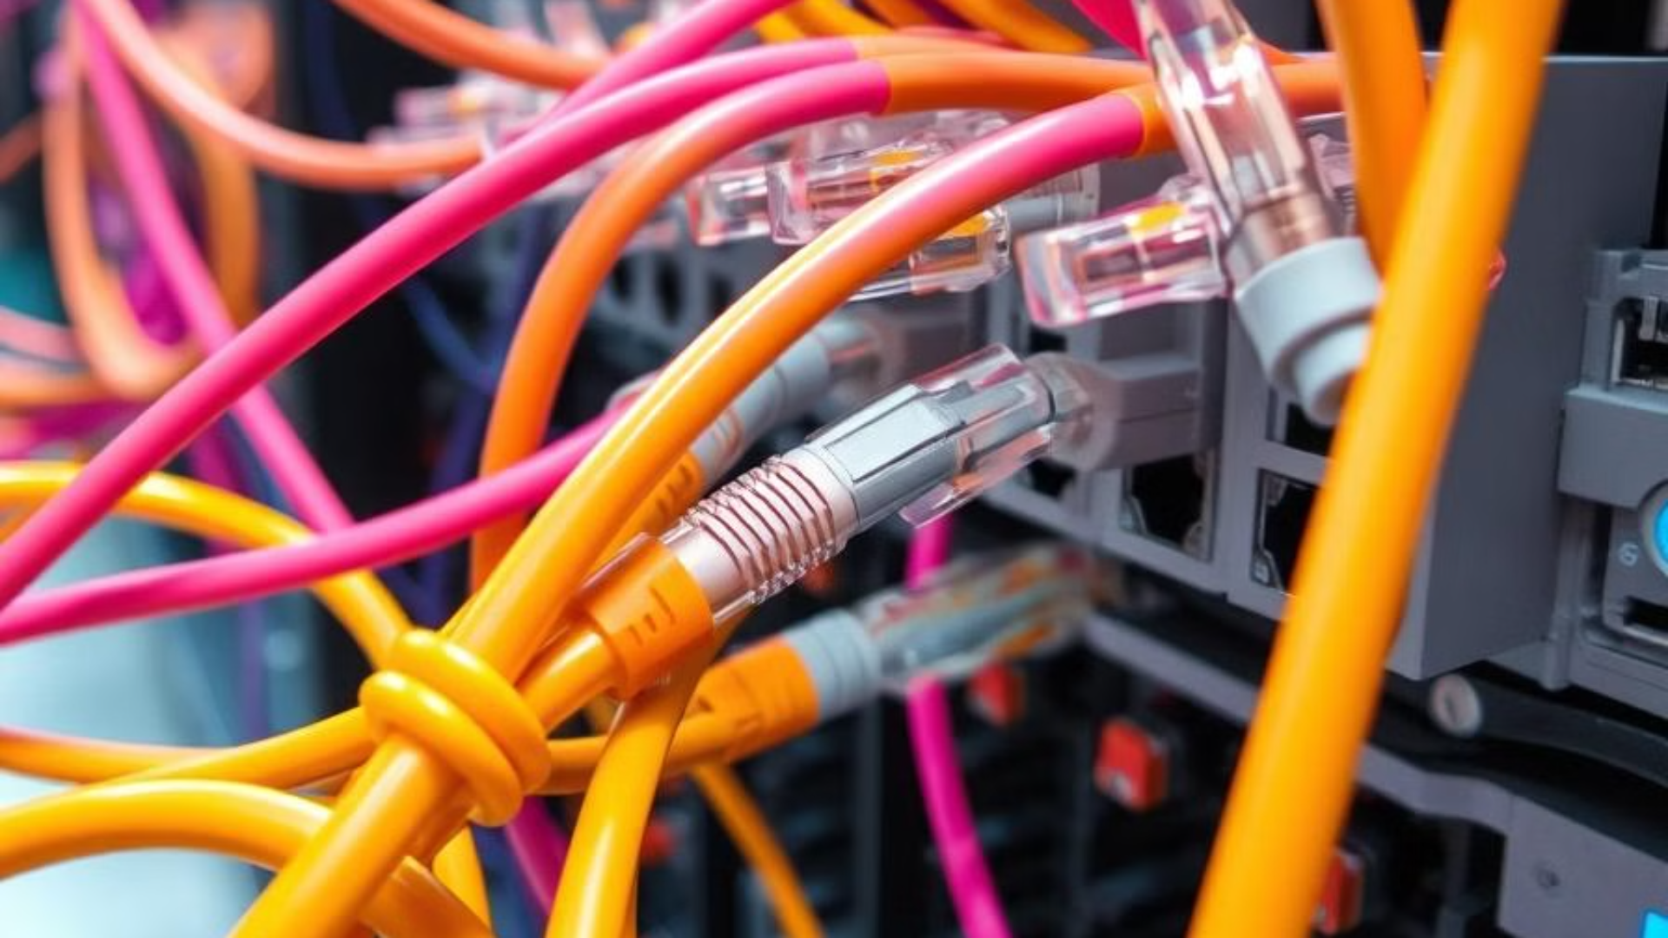
Introduction to the EtherCAT Protocol
EtherCAT (Ethernet for Control Automation Technology) is an industrial Ethernet protocol designed for real-time control applications.
1/16

Slide 2
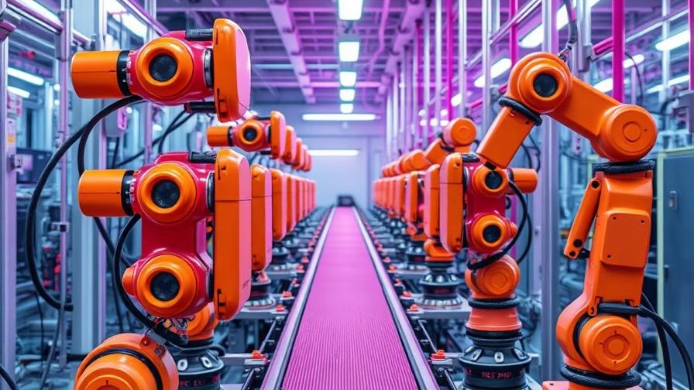
EtherCAT Applications
Robotics Control
CNC Systems
Test & Measurement Systems
Automotive Industry
Power & Energy Systems
Packaging & Printing
Rail & Traffic Control
Medical Systems
Industrial IoT (IIoT)
2/16

Slide 3

Reasons for the Development of the EtherCAT Protocol
Need for High Speed and Low Latency in Industrial Automation
Increasing Complexity and Number of Connected Devices in Industrial Systems
Need for High Precision in Control System Synchronization
Reducing Hardware Costs and Optimizing Resource Utilization
Compatibility with Standard Ethernet and the Need for System Integration
Need to Improve Security and Reduce Communication Errors
3/16

Slide 4
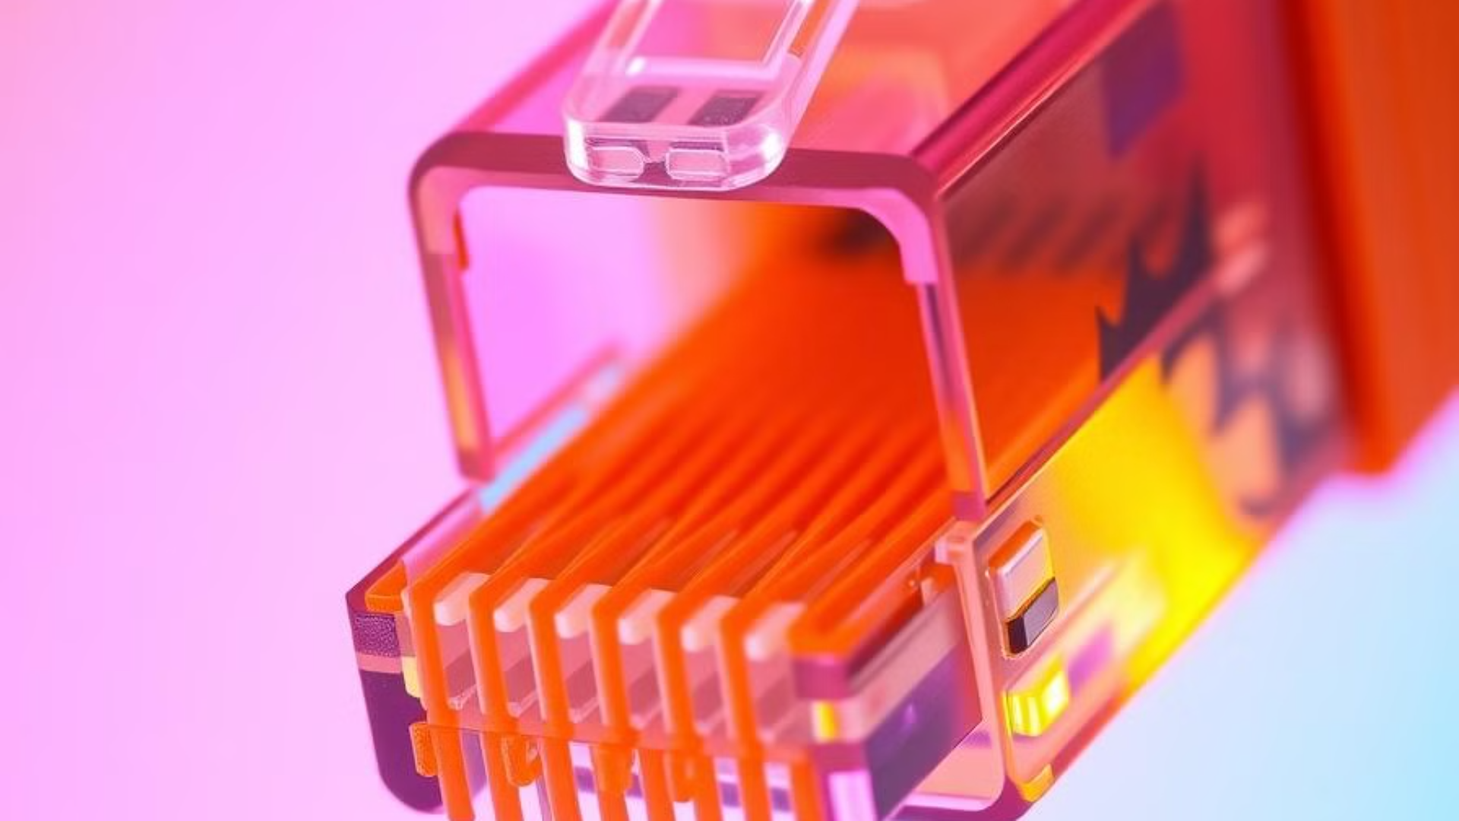
Physical Layer Connections and Circuits
EtherCAT uses the IEEE 802.3 Ethernet standard and differential signaling for reliable communication.
It transmits data through two twisted pairs of wires with opposite electrical potentials for noise reduction.
Connections include Ethernet (RJ45 or industrial M8/M12), power supply (24V DC), and differential signals (TX+/TX- and RX+/RX-).
Optional connections include digital/analog I/O, fiber optic cable, and additional ports for redundancy.
4/16

Slide 5

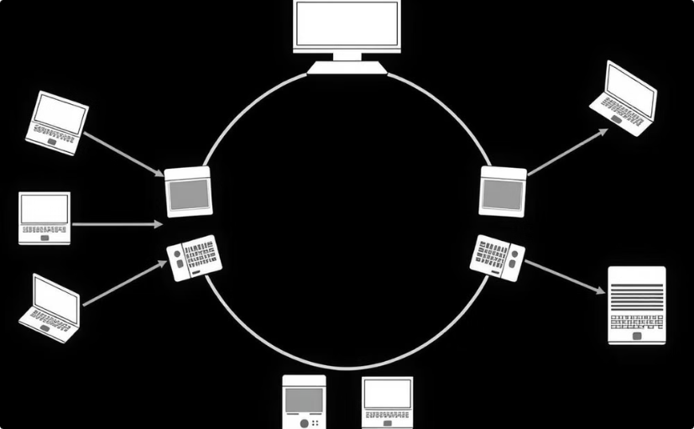
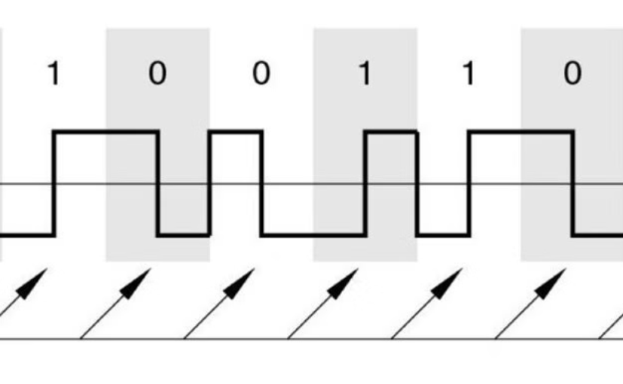
Connection Type and Encoding
Connection Type
Encoding Type
EtherCAT is a serial protocol that transmits data in a ring or daisy-chain structure through Ethernet cable
EtherCAT uses Manchester encoding, which is defined in the 100BASE-TX Ethernet standard
5/16

Slide 6

How to Connect Devices
Ability to Connect Multiple Devices
Collision Management
The EtherCAT protocol allows you to connect multiple different devices or hardware modules. Using this protocol, you can connect various types of devices to a single network.
Collision management in EtherCAT is done using a precise and efficient mechanism. In this protocol, there is a Master device responsible for controlling and managing the network.
This feature is particularly useful for complex industrial automation systems with a large number of devices.
The Master is responsible for the precise timing and Real-Time communication loop, as well as managing the data position structure within the frame. This approach helps prevent collisions and ensures efficient data transfer.
6/16

Slide 7
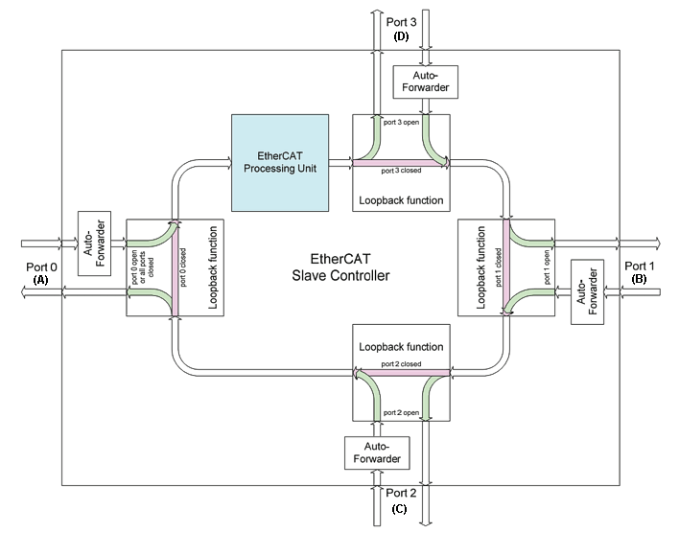
7/16

Slide 8

Data Management
Addressing in EtherCAT
Routing in EtherCAT
Auto-Increment Addressing
Chain structure and direct frame processing
Configured Addressing
Loopback mechanism if needed
Ethernet MAC Addressing
EtherCAT does not require complex routing
8/16

Slide 9





Data Flow Management
1. Initial Configuration
System Configuration Tool generates network info.
2. Information Processing
ENI sent to XML Parser.
3. Command Execution
Master Driver processes and prepares data.
4. Network Transmission
Master Driver transmits via Ethernet MAC.
9/16

Slide 10
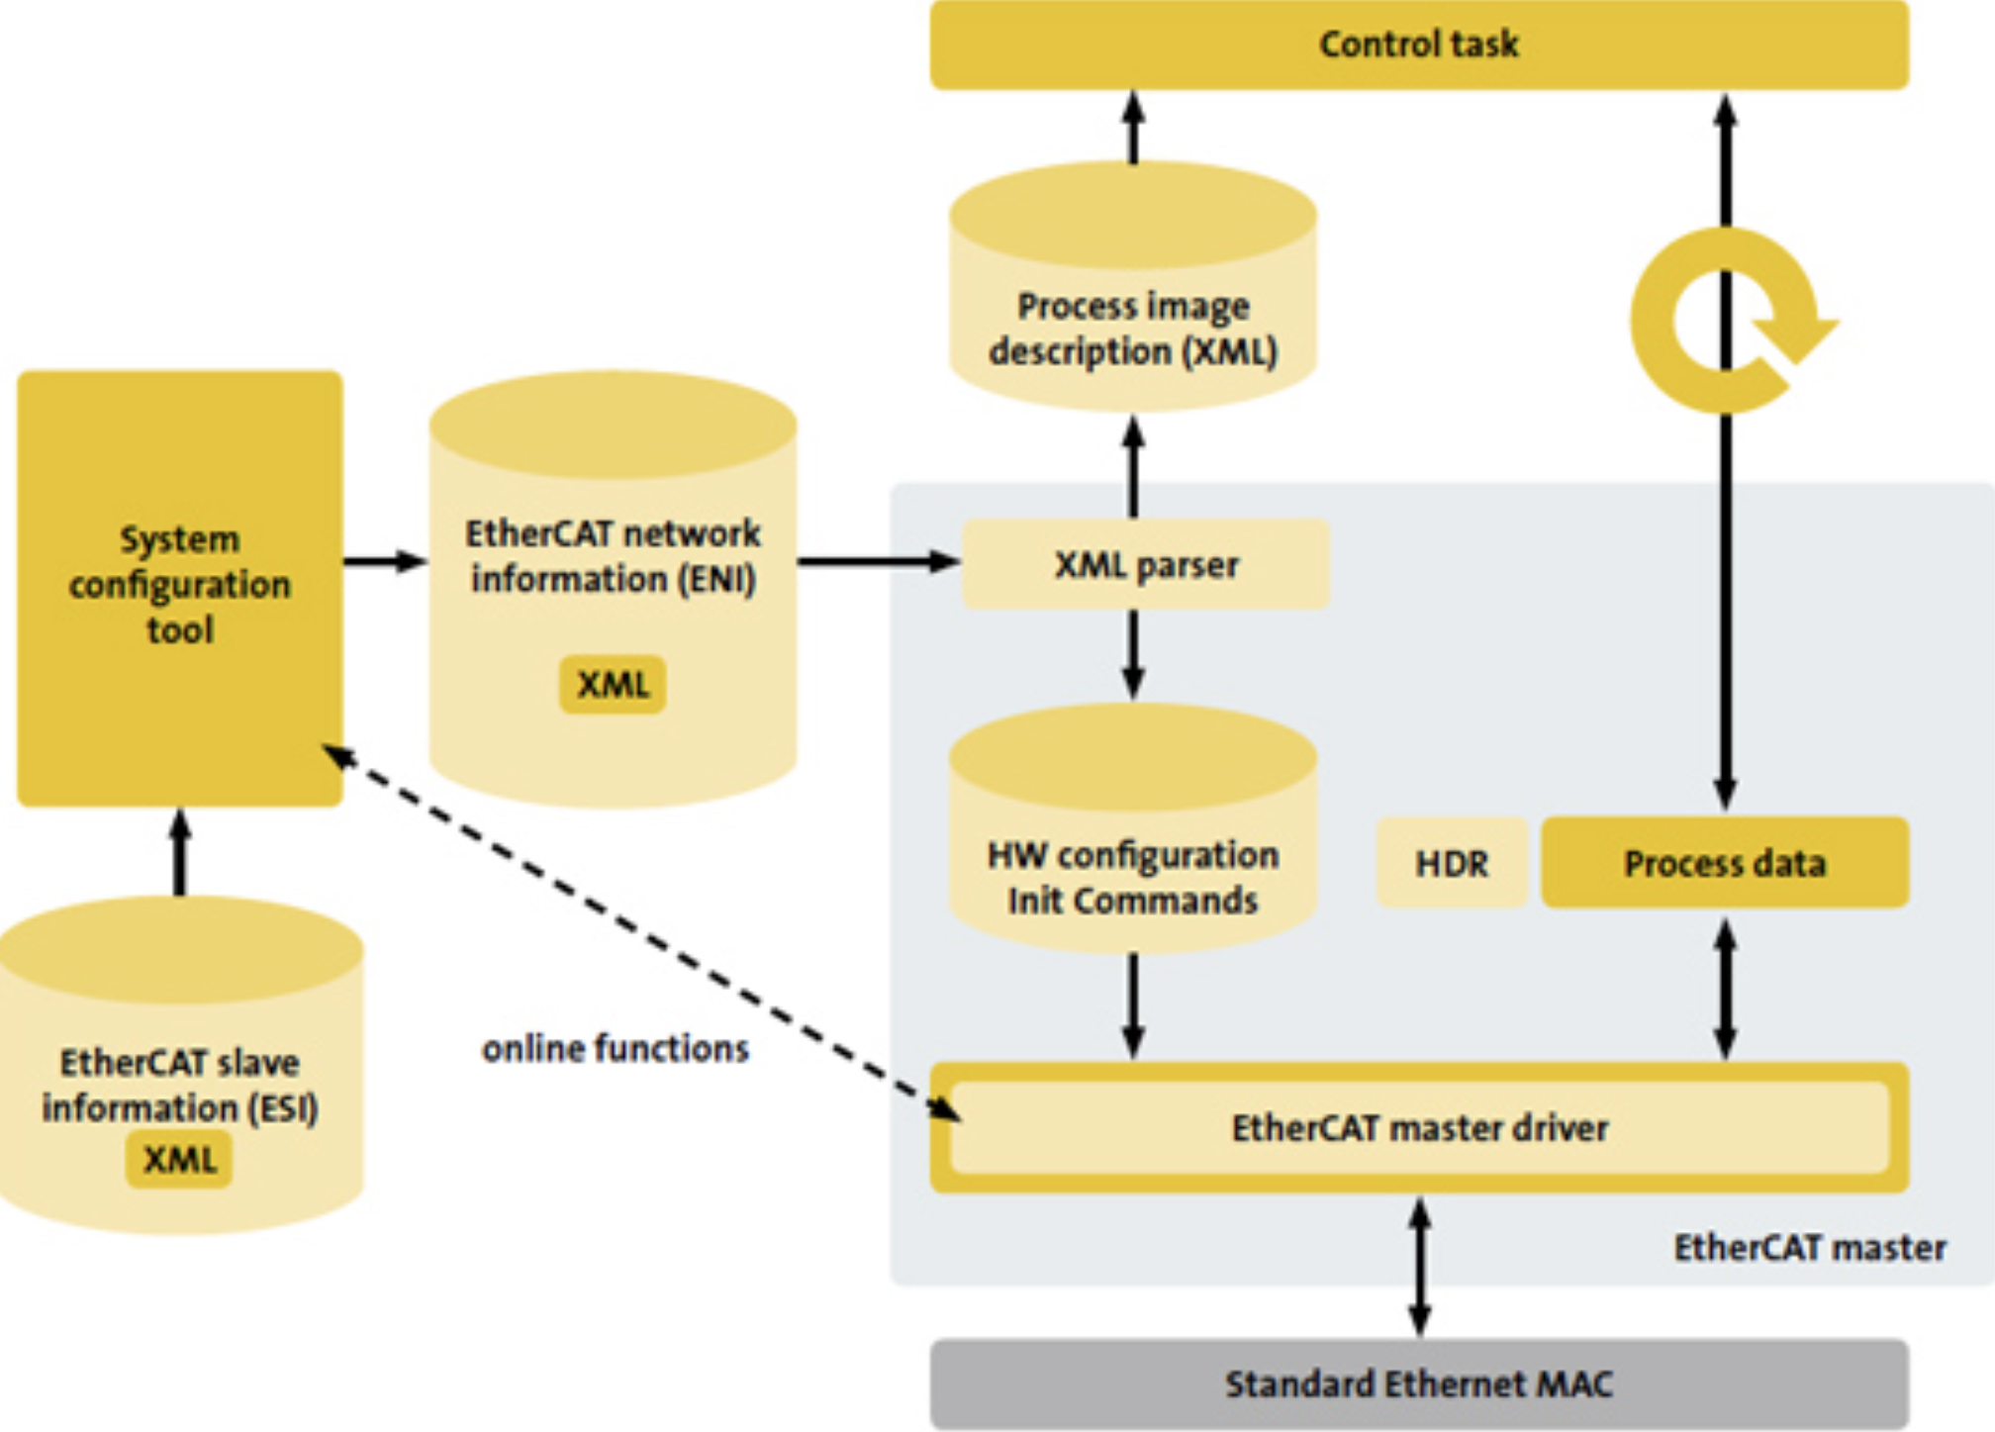
10/16

Slide 11
Error Detection and Correction in OSI
1
Physical Layer
2
Data Link Layer
3
Network Layer
Errors caused by noise, interruption or signal quality degradation
Strong protective mechanisms for detecting and correcting data errors
Monitoring network status and detecting unwanted changes
4
Transport Layer
5
Application Layer
Detecting communication problems and supporting redundant ring topology
Configuration, software or issues in the control program
11/16

Slide 12
Error Detection and Correction Approach
Error Detection
Error Correction
EtherCAT is designed to minimize errors through robust detection mechanisms.
Unlike TCP/IP, EtherCAT relies on immediate error detection and fast retransmission.
Master/Slave architecture limits error potential
Master automatically re-sends faulty packets
CRC checksum verifies data integrity
Redundant Masters and communication paths enhance reliability
Working Counter (WKC) tracks data packet sequence
Bit error correction prevents data frame corruption
12/16

Slide 13
Types of Messages in EtherCAT
Process Data Messages (PDM)
Service Data Messages (SDM)
Mailbox Messages
Used for sending and receiving I/O data from slave devices. These messages are optimized for low latency and Real-Time control.
Used for configuring, reading, or writing parameters in slave devices using the SDO (Service Data Object) model. Primarily used for initial setup and parameter changes, with less stringent response time requirements.
Enable asynchronous communication and the transmission of additional data, including CAN over EtherCAT (CoE) and Ethernet over EtherCAT (EoE). These messages facilitate alerts, log transmissions, and more complex settings.
13/16

Slide 14
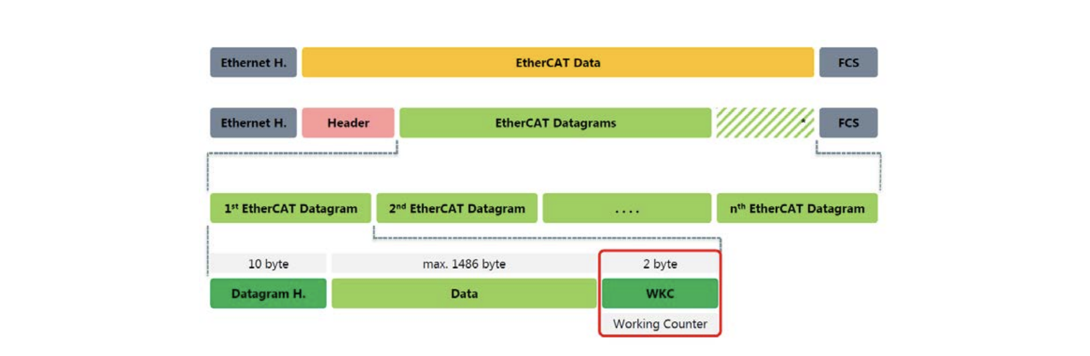
14/16

Slide 15
Resources
EtherCAT.org - Why Use EtherCAT
EtherCAT.org - Technology
Dewesoft - What is EtherCAT Protocol
EtherCAT.org - Ethernet Introduction
Wikipedia - Ethernet Physical Layer
EtherCAT.org - Diagnosis for Users
15/16

Slide 16

Thanks!
Do you have any question?
Presenter: Mohammadfarhan Bahrami
Contact me: mmdfarhanbahrami@gmail.com
Course Instructor: Dr. Foshati
16/16

